Slide 1
Intro to Programming
Class 2: Let’s get moving!
November 2021
Emily Gelfand
Emily Joyce

Slide 2

Disclaimer
I will be running through the basics, and potentially skipping some depending on time. This is meant to be an intro/overview, so absorb what you can now and go back over this later on your own time if you think you need to nail it down further. Don’t worry if it feels like a lot – it is!

Slide 3
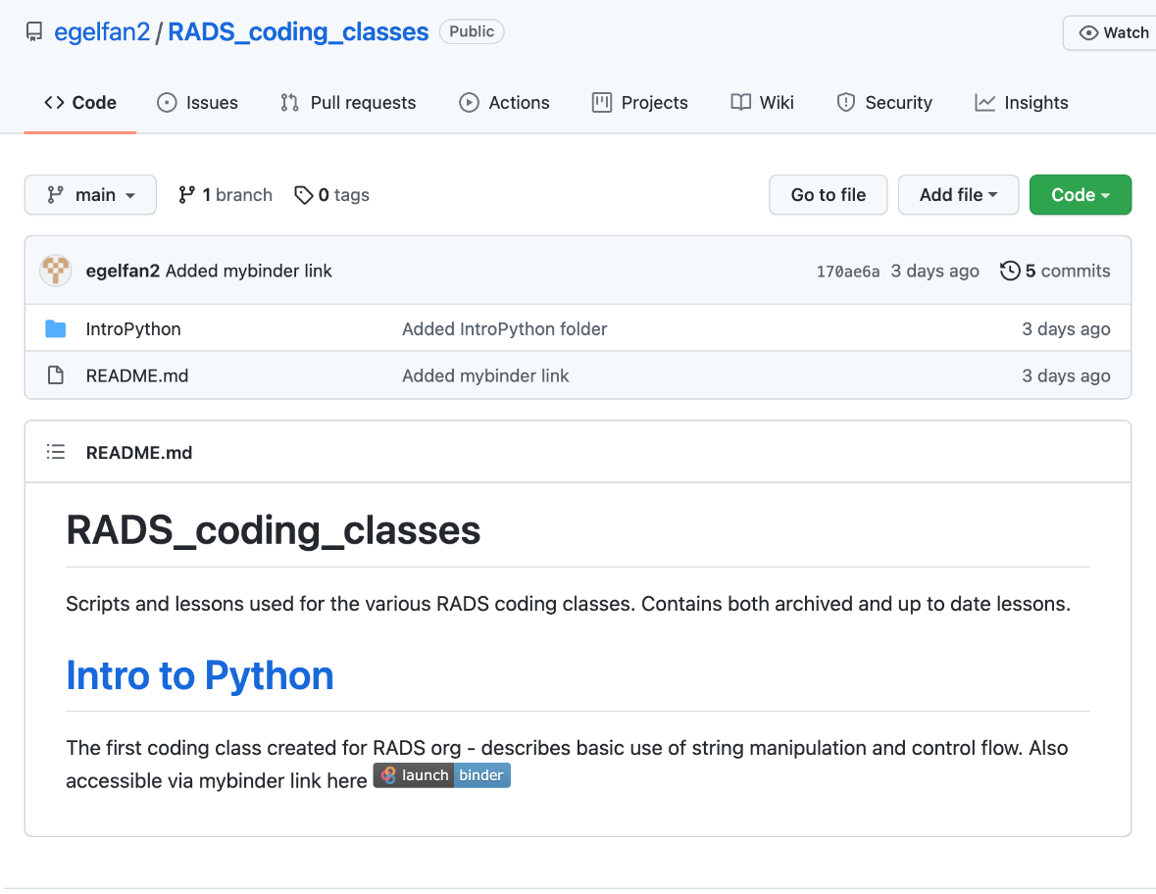
Getting started
We are going to skip installing python for this class and instead practice coding in our browsers.
Go to https://github.com/egelfan2/RADS_coding_classes in your browser
Click on launch | binder

Slide 4
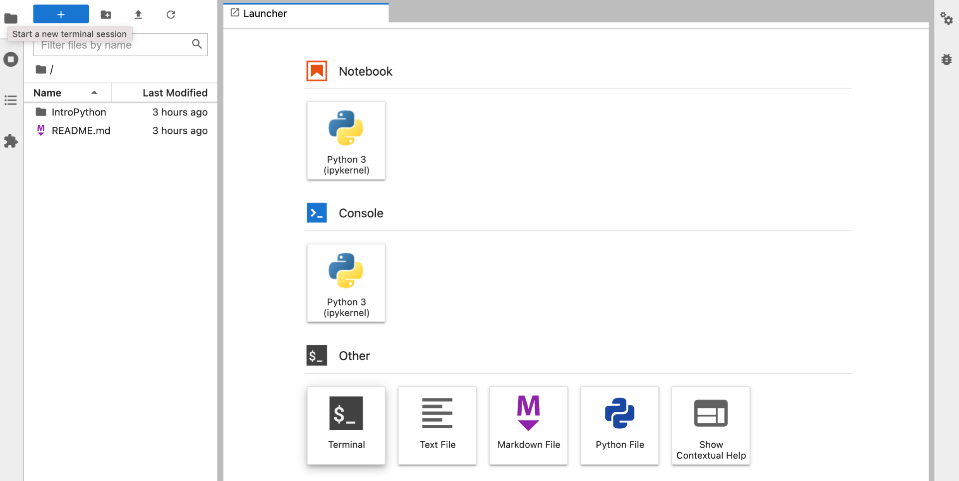
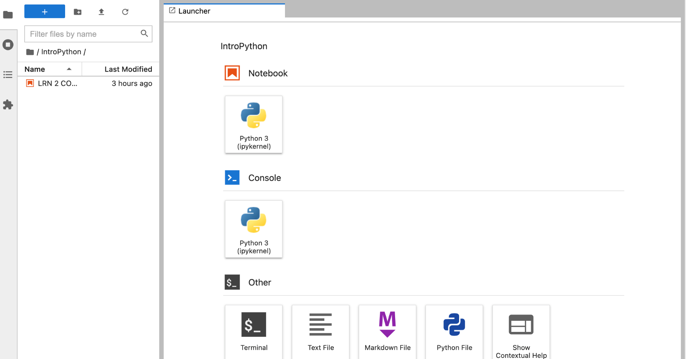
Getting started
Click the IntroPython folder
Click on LRN_@_CODE_2 to open the jupyter notebook file for today

Slide 5
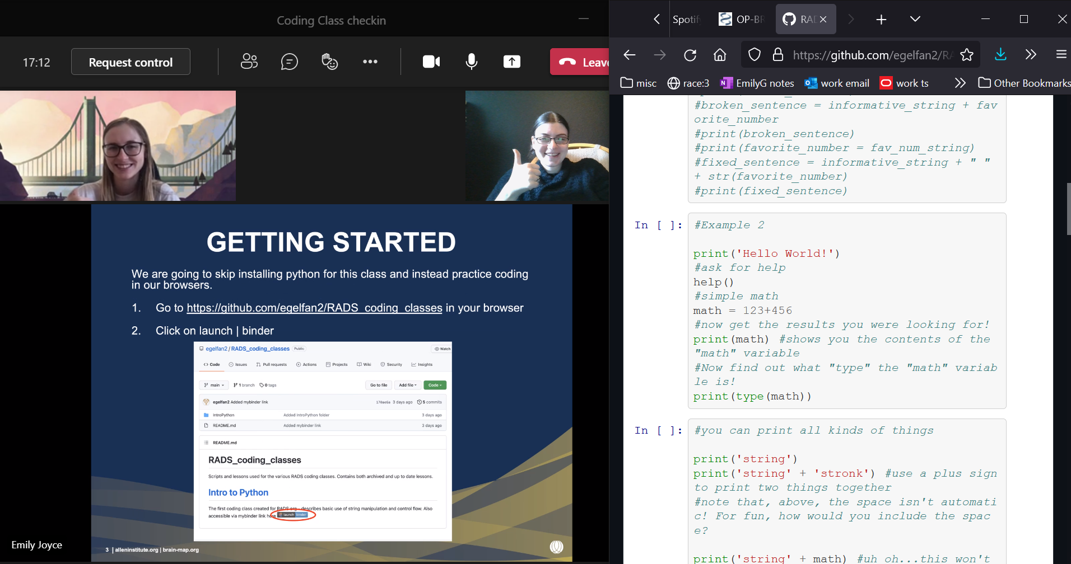
Viewing setup
We suggest that you pull up the jupyter notebook to one side of your screen and watch the lecture slides on another side

Slide 6
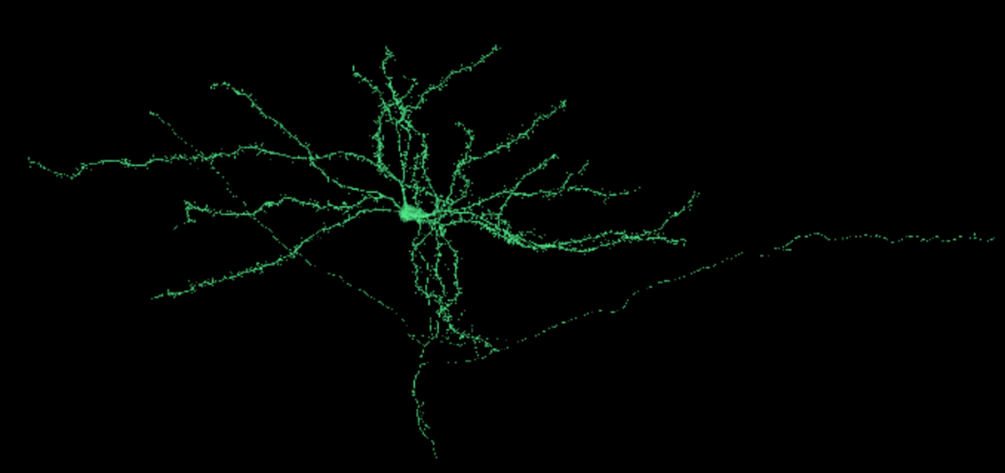
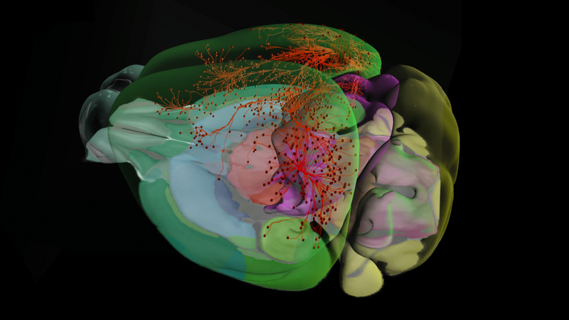
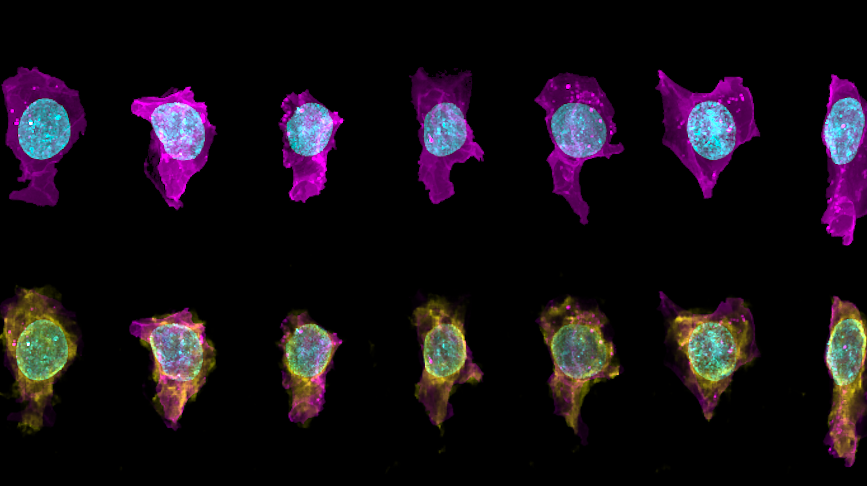
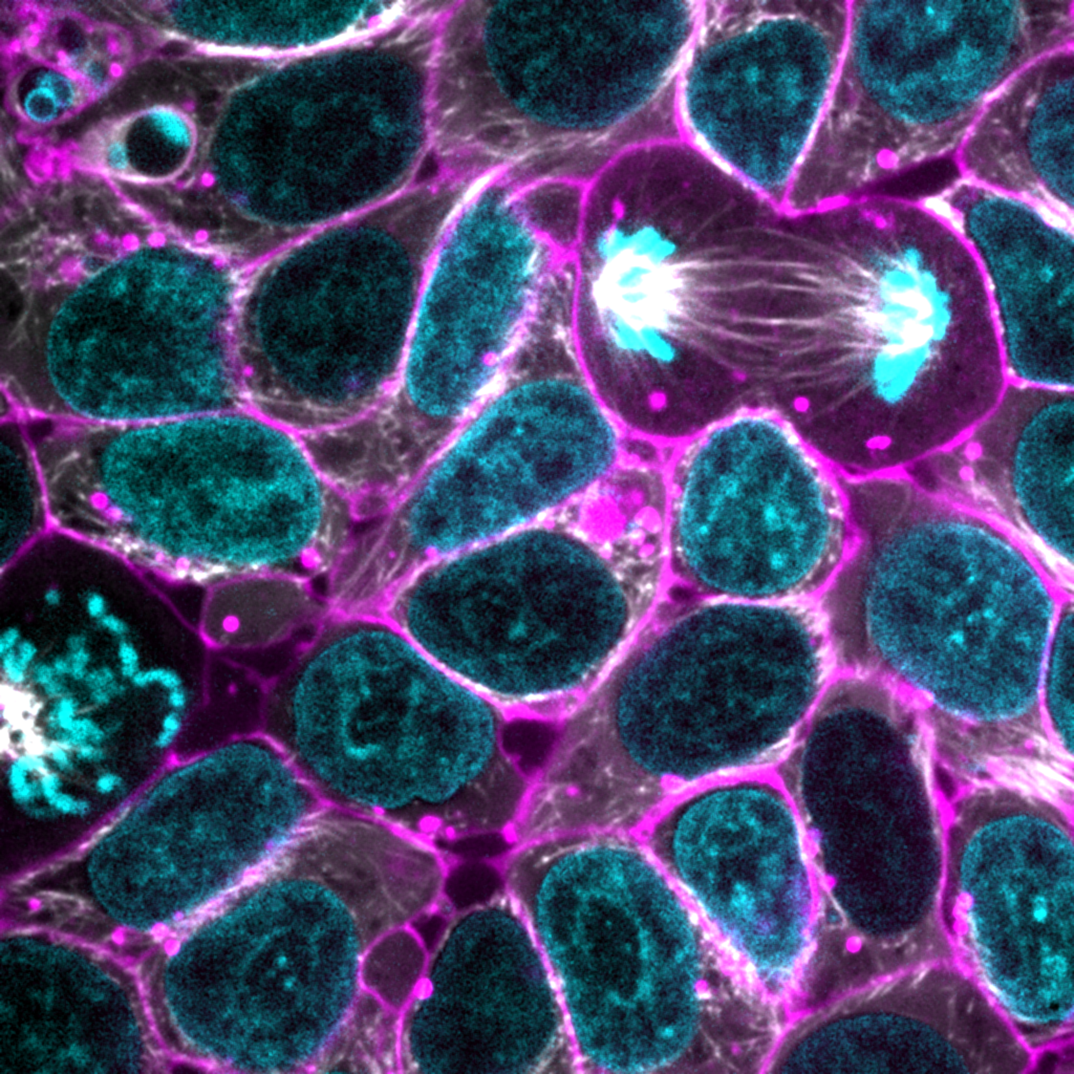
Lesson Plan
Learn about some tools that will help us solve some practice problems inspired by work we do at the Allen Institute

Slide 7
Review from last class
Quick types/variables summary from last lesson
Notes:
Going to quickly refresh your memories on some of the things we touched on last time that we’ll actually start using this time.

Slide 8
Review - Types Cheat Sheet
Name | Type | Description
Integer | int | Whole numbers, such as: 3 300 200
Floating point | float | Numbers with a decimal point: 2.3 41.6 507.912
String | str | Ordered sequence of characters: ‘hello world’ ‘Jack123’ “200” “馬 / 马”
List | list | Ordered sequence of separate objects: [15, “dog”, “200”]
Dictionary | dict | Unordered key:value pairs: {“key here” : “value here”, “name” : “Emily”, “workplace”: “Allen Institute”}
Set | set | Unordered collection of unique objects: {‘a’, ‘b’, ‘c’}
Boolean | bool | Logical value indicating True or False

Slide 9
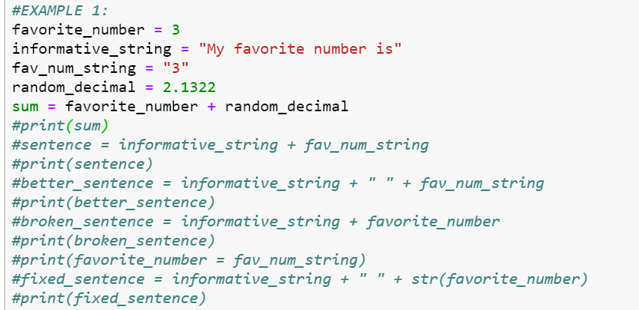
Data Types Matter!
Example 1:

Slide 10

Variables
Regardless of which data type you’re using, at some point, you’ll want your code to actually do something (don’t we all). In order to run anything, what you’ll have to do is store information in what’s called a variable, or a way of telling your computer what data to store.
Variables can be named whatever you want, but beware of falling into a few classic traps:
Python (and most other languages) have something called “Keywords”, or words that can’t be used as variable names, function names, or other identifiers, as they’re used to define the structure of the language itself (more on that later)
If you name a variable a single letter when writing code someone else might ever have to look at, you’re going straight to heck.
Notes:
Just like in math! Jupyter notebooks it’ll change color (keywords).

Slide 11
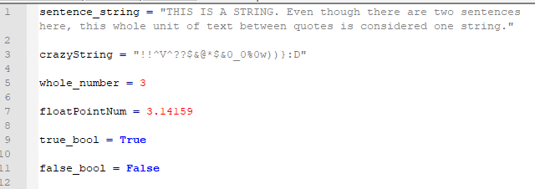

How can I hold all this information?
The previous data types we talked about, stored as variables. Python is a flexible language, which means that it doesn’t make you tell it what data type each variable will be – you just store the variable*
*When writing more complex code in python, such as a larger program or a program that might be used or read by multiple people, it’s considered best practices to declare what “type” you intend a variable to be. This makes the code easier to read and easier to debug. However, when writing one-off scripts, it’s not as critical to do.
Notes:
Equals sign is assignment.

Slide 12
SOLO Practice #1
Solve and save the result of 23 * 71 as a variable
Now solve and save the result of 6 to the power of 3 as another, differently named variable
Finally, check if the second result is greater than the first result and print the final answer!
Notes:
Show us what you got! Go to your notebooks and try solving these problems. You’ll have the answer sheet available, but don’t use it unless you really feel stuck and neither Emily nor I can help you. Notice that your answer was a boolean!

Slide 13
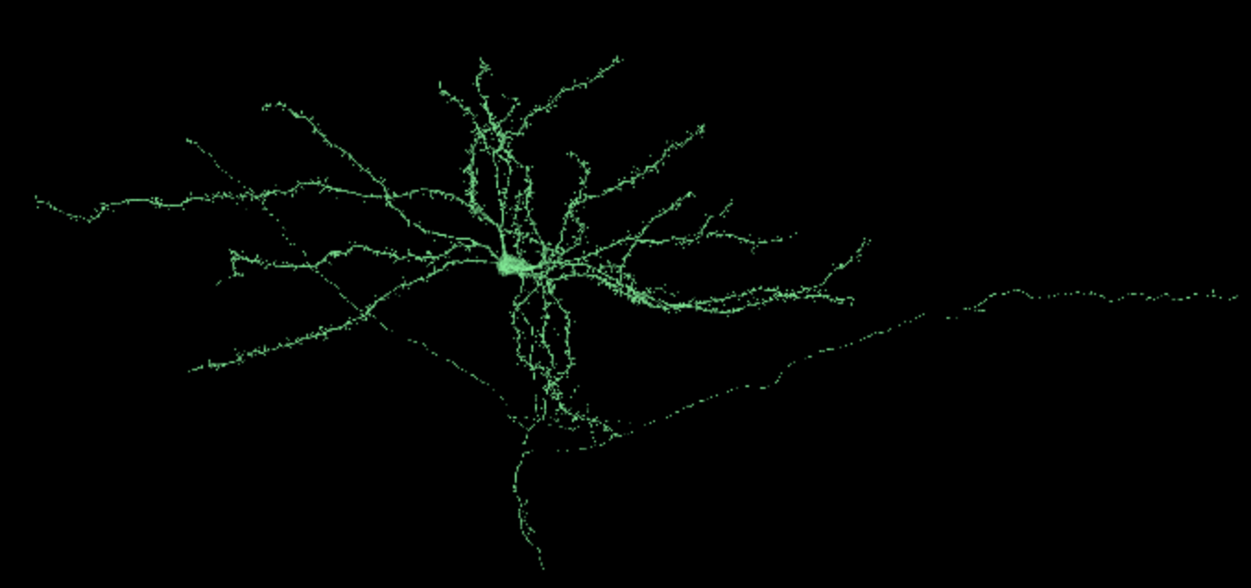
Exercise 1 – What cell type is this neuron?
You come across a neuron that you are not familiar with, and you need to figure out what cell type it belongs to.

Slide 14
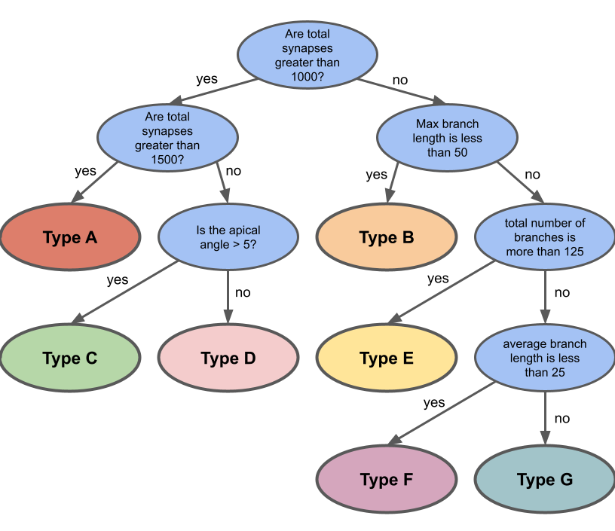
Exercise 1 – What cell type is this?
Luckily, your lab has a decision tree that helps you to figure out which cell type a given neuron is!
We have all the information on this neuron that we might need to solve this problem and more:
Neuron id= 864691136423030063
size = 290710
Number of presynaptic sites= 79
Number of postsynaptic sites = 805
soma layer = 5
apical angle = 7.928
branch lengths = [ 7, 39, 2, … 41]

Slide 15

New Information: tools for solving Exercise 1
Comparison Operators
Functions
Python Built-In Functions
Notes:
Going to quickly refresh your memories on some of the things we touched on last time that we’ll actually start using this time.

Slide 16
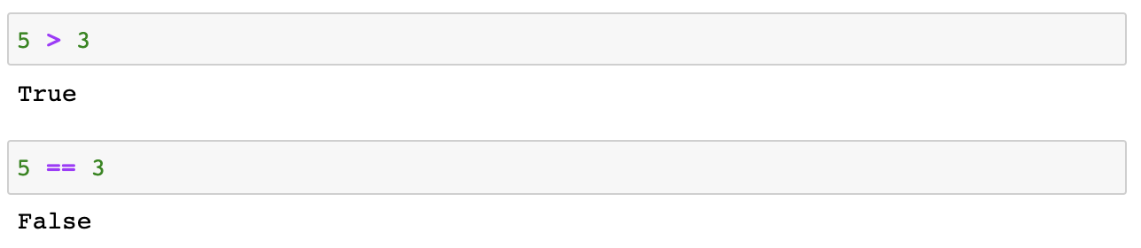
Comparison Operators
Name | Operator | Example
Equal | == | X == Y
Not Equal | != | X != Y
Greater Than | > | X > Y
Less Than | < | X < Y
Greater Than or Equal to | >= | X >= Y
Less Than or Equal to | <= | X <= Y

Slide 17
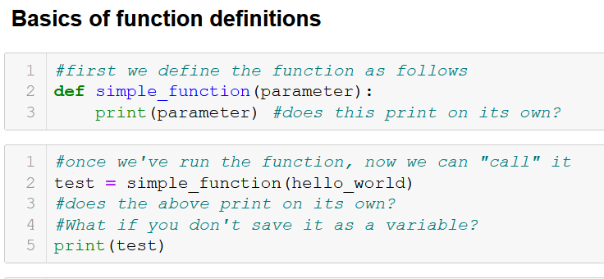
Functions
A function is a block of code which executes when it is called. You can pass data, known as parameters, into functions, or they can run on their own. A function can return data as a result, or simply perform an action. See the example below in your notebooks.

Slide 18
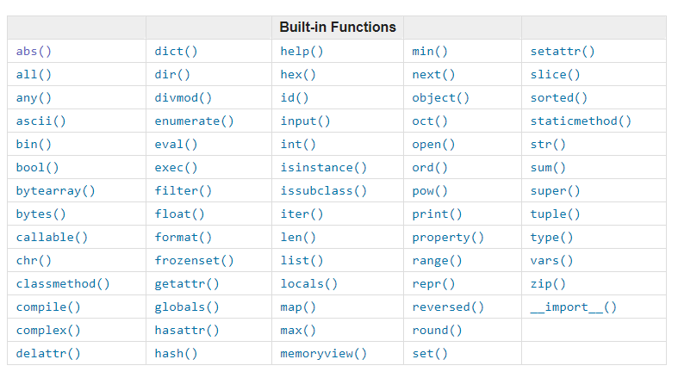
Built in Functions

Slide 19
Built in Functions that you might recognize
Notes:
These functions will create a data type when you pass it information – dict creates a dictionary, float creates a floating point number, list creates a list, str creates a string. These built in functions are nice because they can translate one datatype into another!

Slide 20
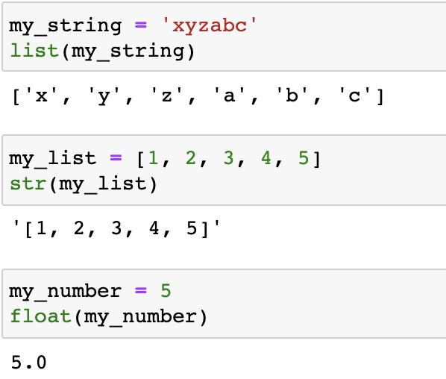
Casting (no not spells)
Want to change the type of whatever you’ve written? Use casting!
You can cast most things to most types, but below (and in your notebooks) we’re just giving you a few examples.

Slide 21
Built in Functions for our exercises
Notes:
These are the built in functions that we are going to be using in our examples, so let’s go over them in a bit more detail!

Slide 22
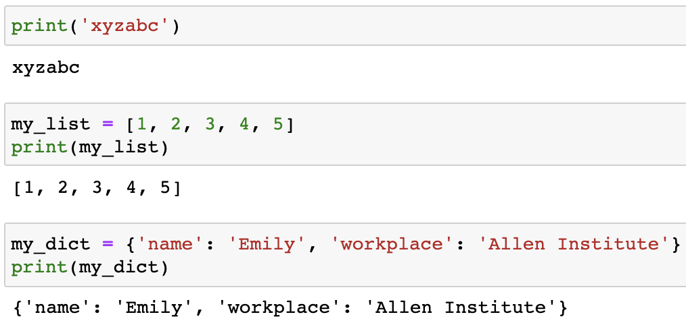
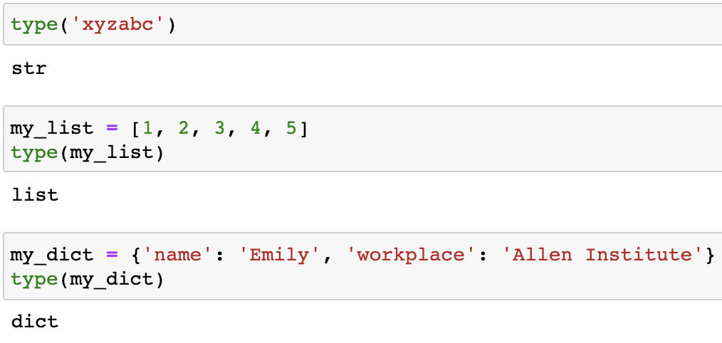
Our Built-in Functions
print()
Shows the contents of whatever you pass in the parentheses
type()
Returns the type of whatever object you pass it
Notes:
The ever critical Print command:
Print() does what it says on the box – shows you the contents of whatever you’re asking to print! It can be a variable name, a command, text, anything.
Critical for basically everything you want to do – otherwise you won’t see what’s going on in there! The only thing you’ll need to keep in mind is that the types need to match- if you try to print(‘string’ + 7) you’ll get an error, whereas print(‘string’+’7’) will give you ‘string7’
Type command:
Type(variable_name) gives you the “type” of variable_name, (i.e. “int” or “string”)
Very useful to check if you’re seeing a TypeError – that usually means that you’ve accidentally/unknowingly changed the variable type without realizing!

Slide 23
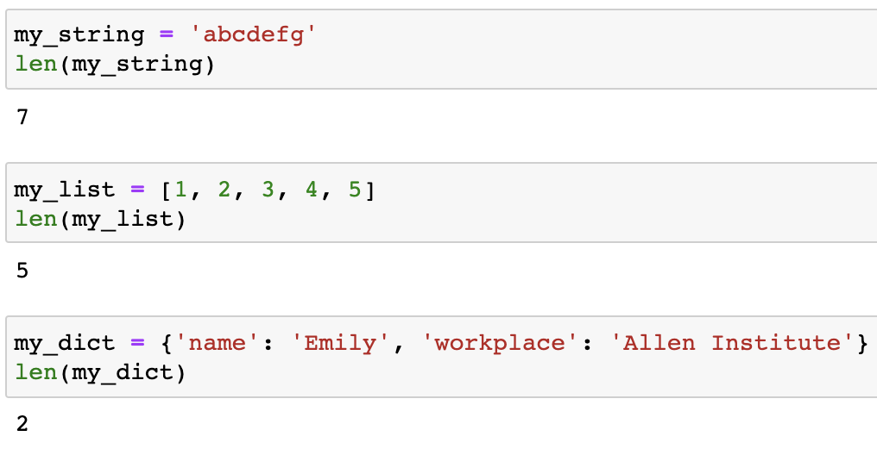
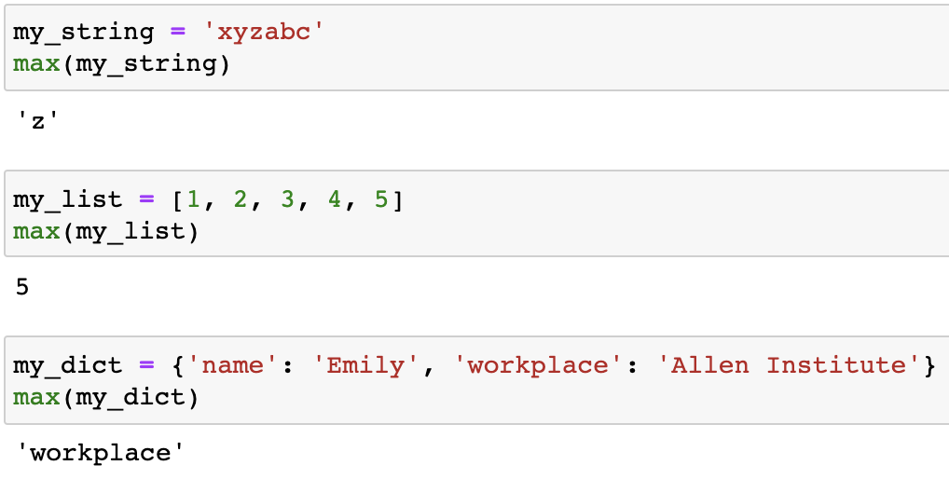
Our Built-in Functions
len()
Takes in a list, a string, dictionary etc. and returns the length of that object
max()
Takes in a list, a string, a dictionary etc. and returns the item with the highest value

Slide 24
Exercise 1 – What cell type is this neuron?
You come across a neuron that you are not familiar with, and you need to figure out what cell type it belongs to.

Slide 25
Exercise 1 – What cell type is this?
Luckily, your lab has a decision tree that helps you to figure out which cell type a given neuron is!
We have all the information on this neuron that we might need to solve this problem and more:
Neuron id= 864691136423030063
size = 290710
Number of presynaptic sites= 79
Number of postsynaptic sites = 805
soma layer = 5
apical angle = 7.928
branch lengths = [ 7, 39, 2, … 41]

Slide 27
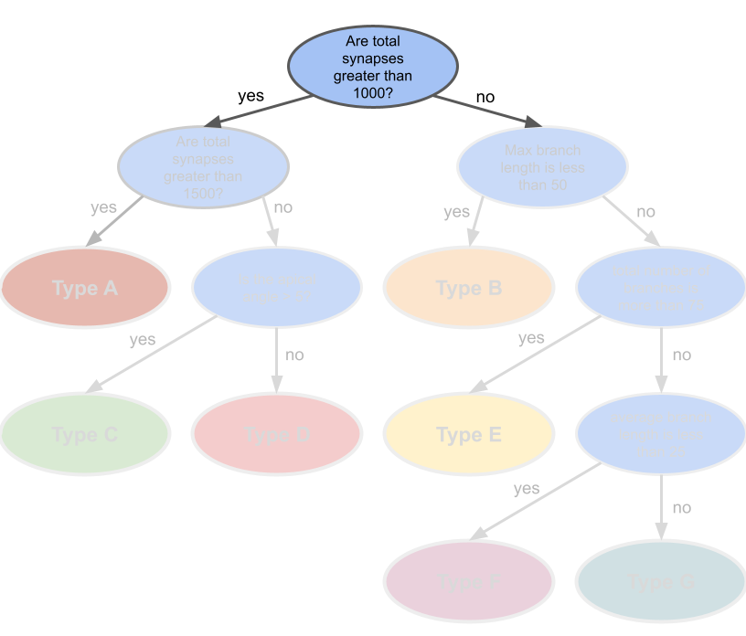

Slide 28
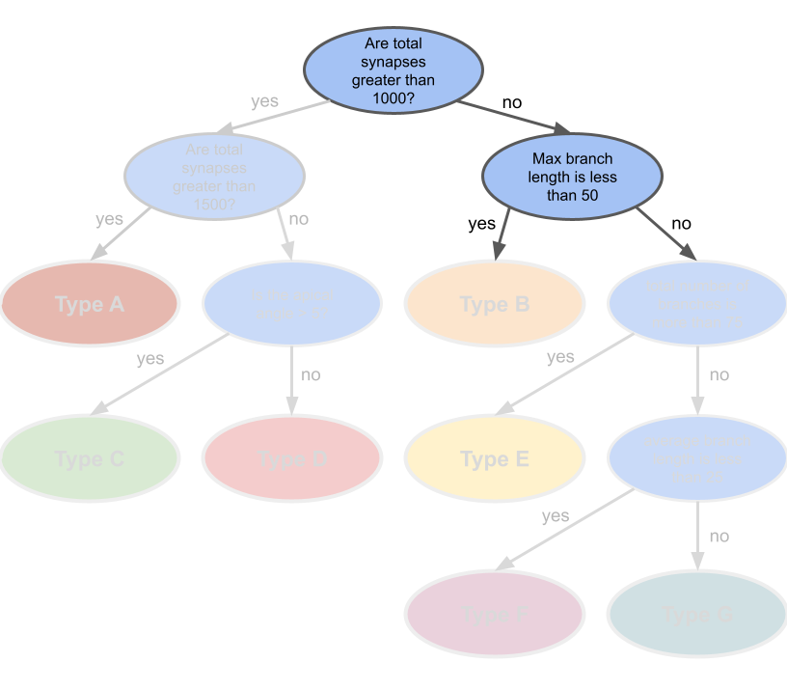

Slide 29
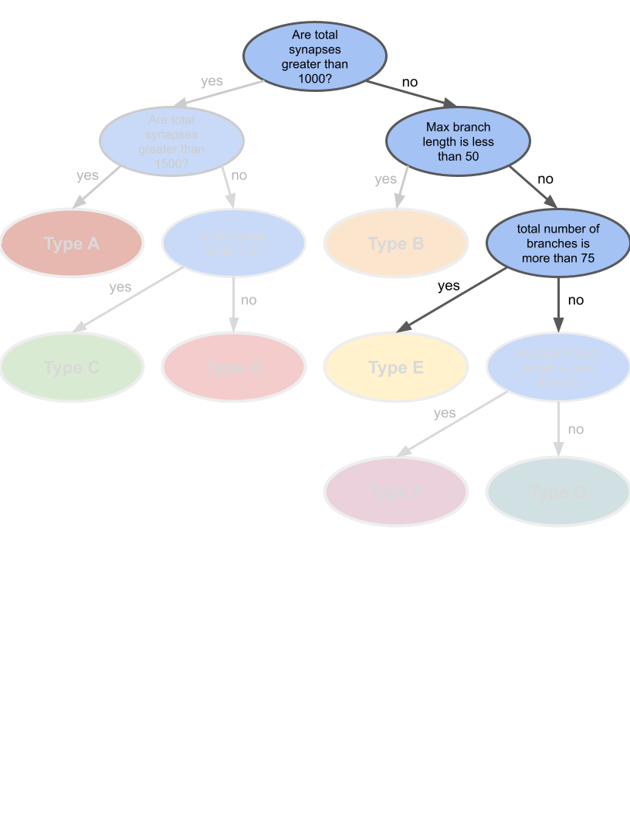

Slide 30
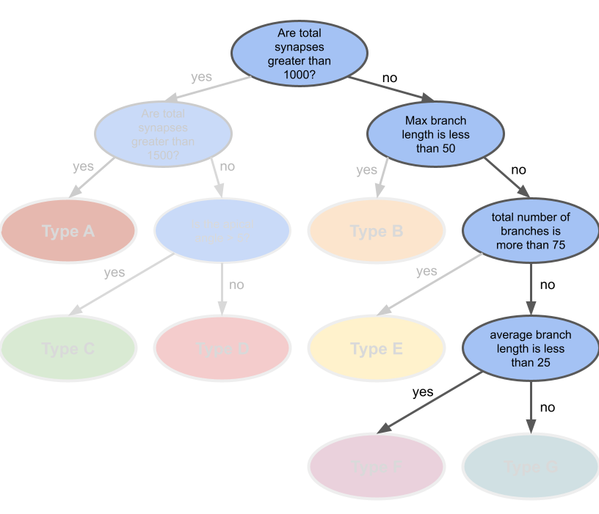

Slide 31
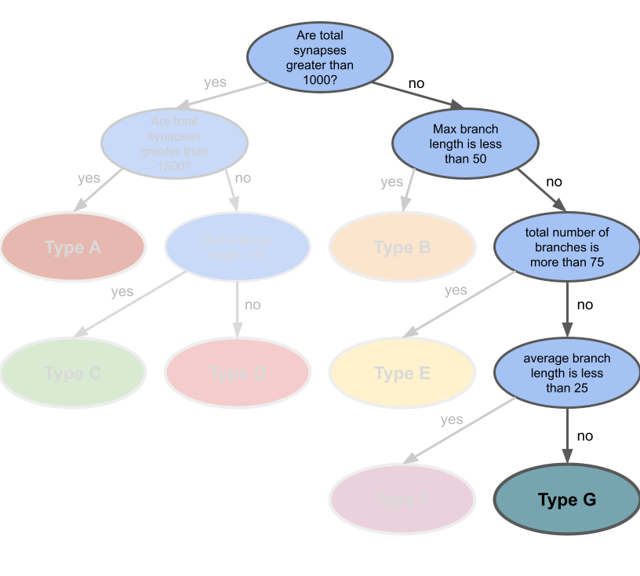

Slide 32

Control flow
Now that we’re getting stronger, let’s talk more complex logic!

Slide 33
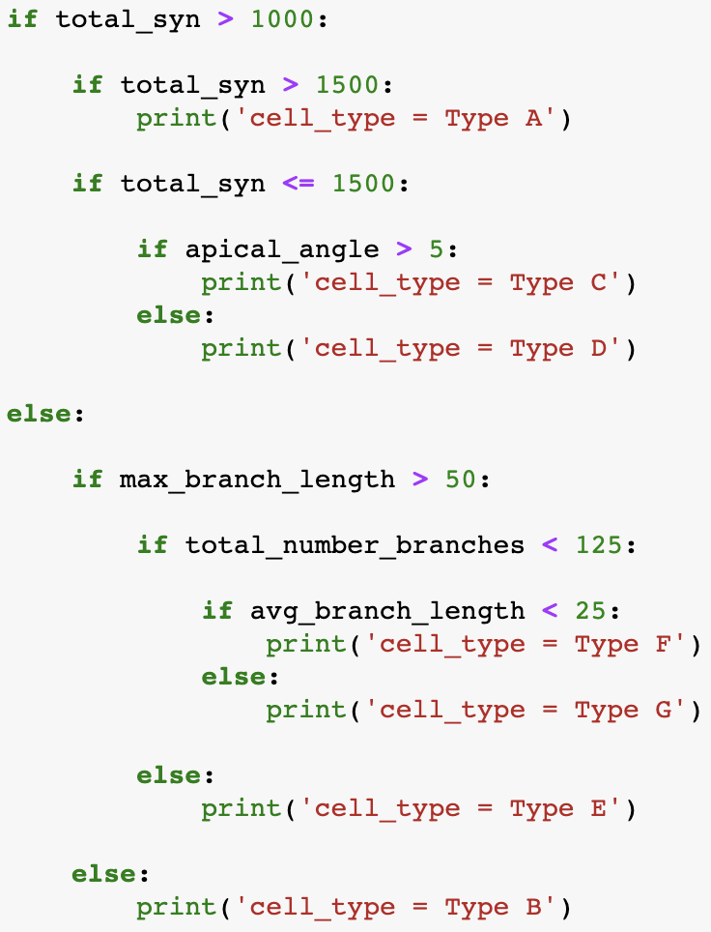
Representing the Decision Tree in Python Code: if/else

Slide 34
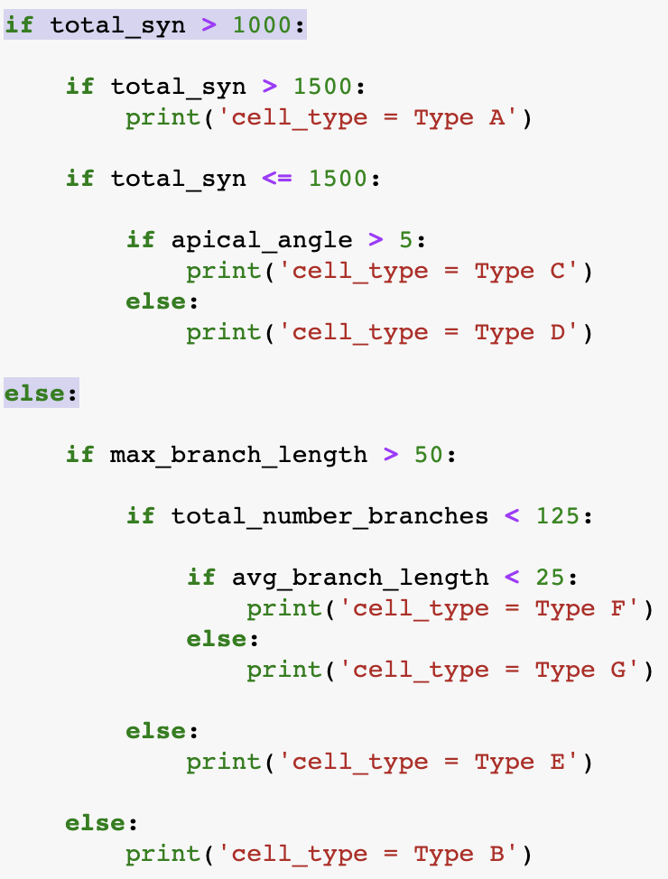
Representing the Decision Tree in Python Code: if/else

Slide 35
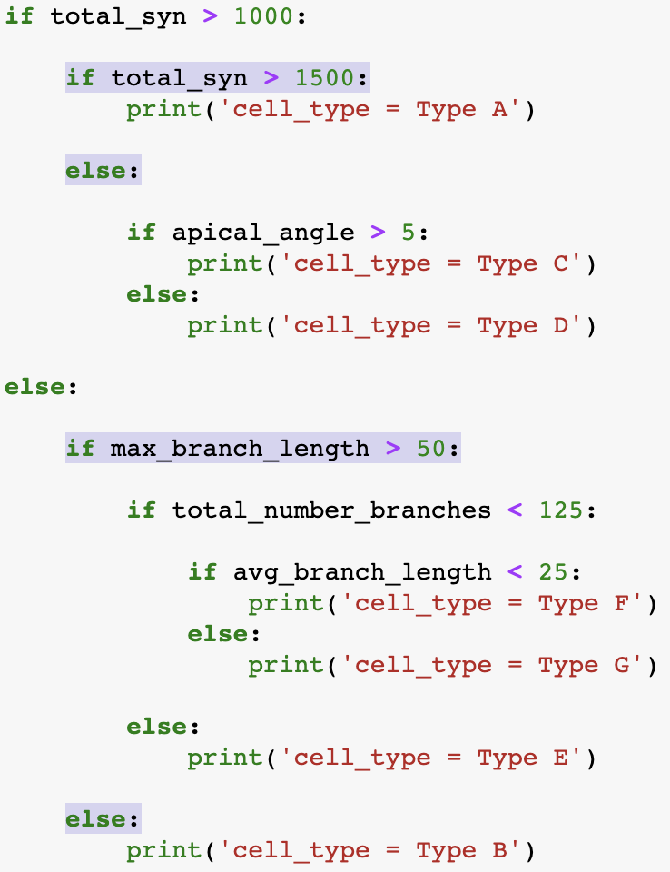
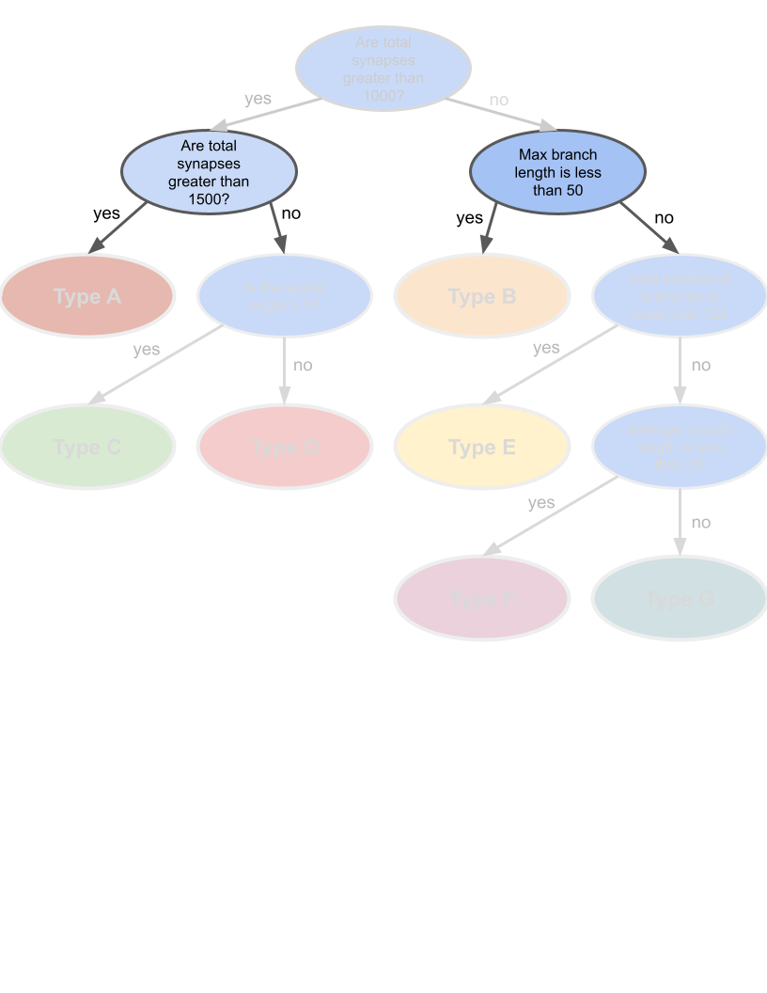
Representing the Decision Tree in Python Code: if/else

Slide 36
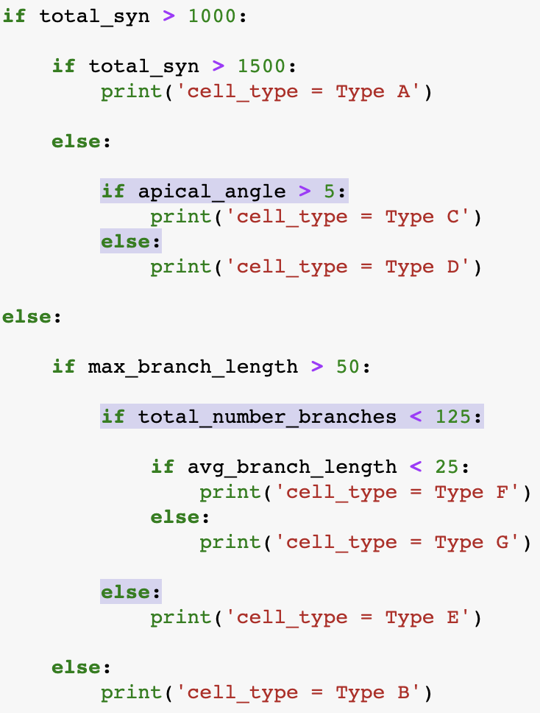
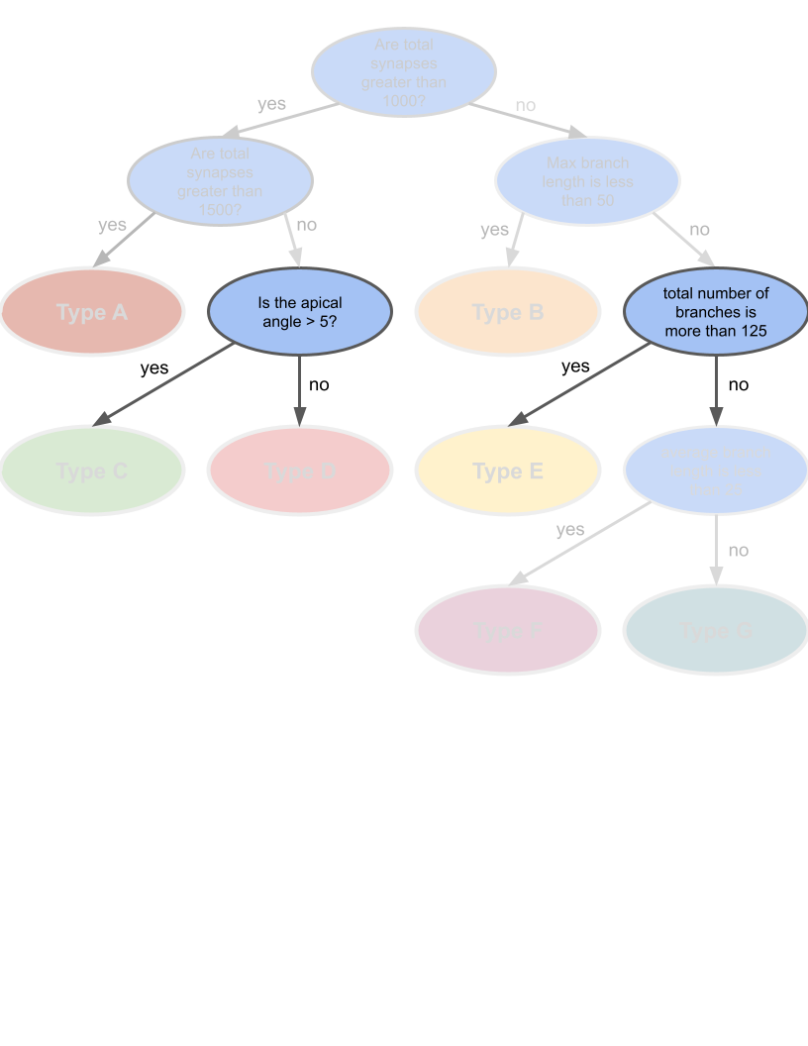
Representing the Decision Tree in Python Code: if/else

Slide 37
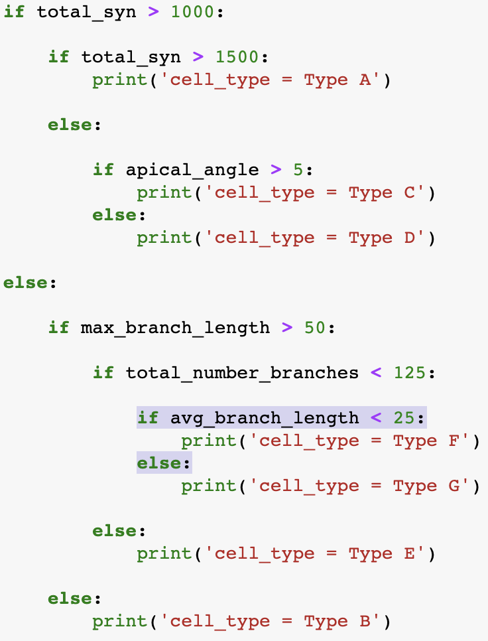
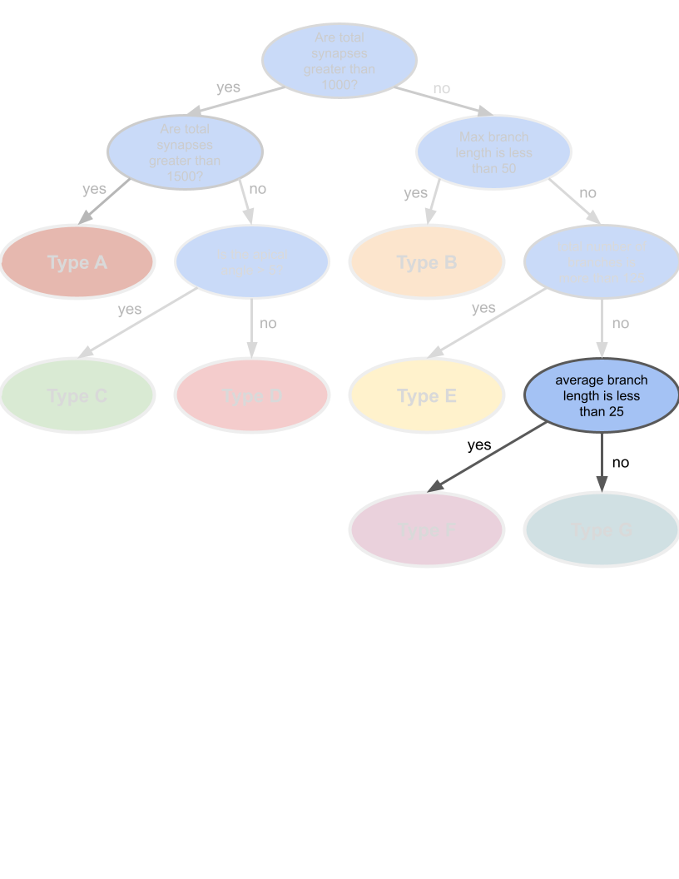
Representing the Decision Tree in Python Code: if/else

Slide 38
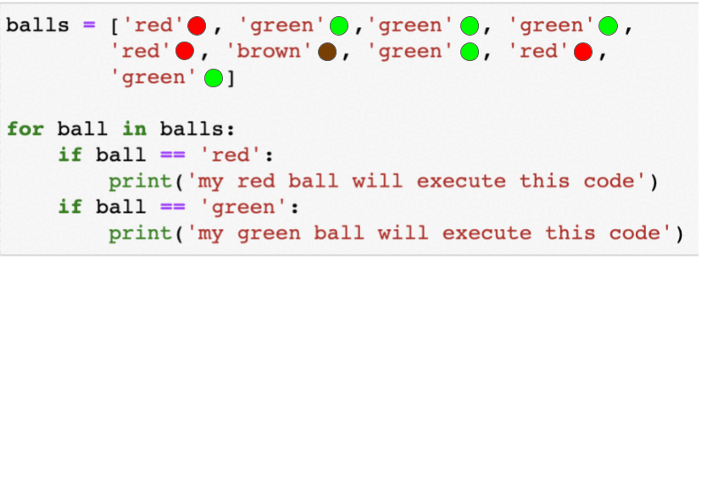
True Power of Python: For Loop!
Notes:
So imagine you had 1000 neurons – you could get their types by looping the list of 100 neurons through the decision tree code!

Slide 39
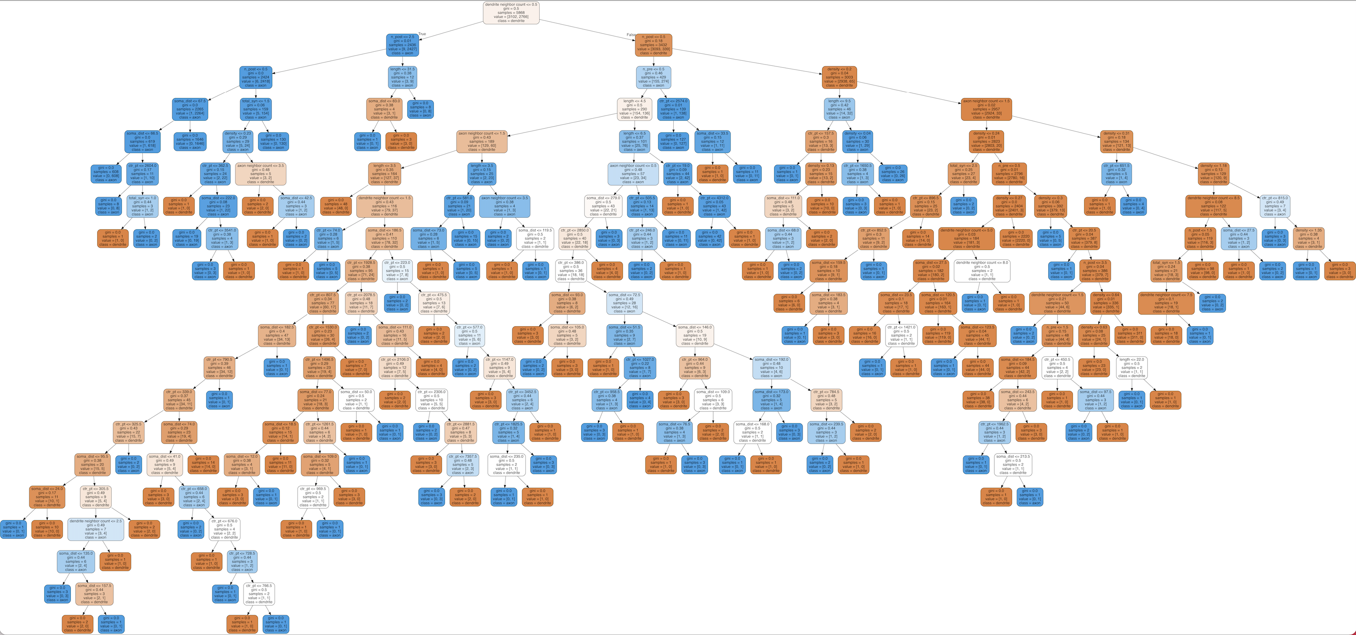
Doing this programmatically with 1000+ neurons is a breeze with python!
Notes:
So imagine you had 1000 neurons – you could get their types by looping the list of 100 neurons through the decision tree code!

Slide 40


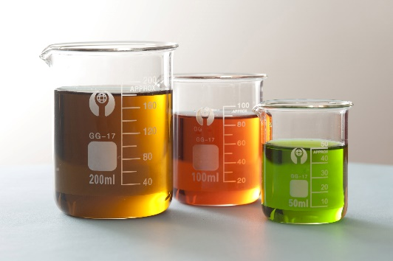
Solo Practice 2
Last week your lab ran the same experiment twice on different days, all using (what they thought) were samples from the same batch. Each experiment should have generated 5 good pieces of data.
However, when the results came in, your team realized that both experiments turned out totally differently! Some of the resulting data was junk, and other parts were perfectly fine, and no one is sure of precisely what was different.
You’ve been asked to investigate the experiment data for a potential cause for your upcoming data review meeting – can you find the answer?
Notes:
This is a real problem I’ve solved just recently for our lab, but I felt like it was generalizable enough that I’ve experienced it in just about every other lab I’ve worked at or with. So, here’s the story: …
As you can see, there’s lots of things that could be the cause here, or could potentially be irrelevant. What does the prompt suggest might be the problem before you even see the data, knowing nothing about the experiment? Rather than doing what people without skills to manipulate data can do, let’s learn how we can find the answer.

Slide 41


Wow, that was a lot!
No worries – all of this information takes time and practice to master. Even if the concepts themselves seem simple, there’s a lot to remember and keep track of.
Remember that you have the power to track these things down, especially if they weren’t covered in this class! Stackoverflow.com and the python documentation combined can give you all the answers you could ever hope for – but asking the right questions takes practice too!
IN SUMMARY: Just keep practicing and you’ll DEFINITELY improve!

Slide 42
Thanks for coming!
Questions? Concerns? Suggestions? Need more info?
Email !RADS_ORG, or comment in the teams channel!
Python documentation: https://docs.python.org/3/, contains a handy tutorials and links to documentation for all versions of python.
We’ll be sending a survey later today, we’d appreciate your feedback for future classes. Thank you!

Slide 43
THANK YOU
We wish to thank the Allen Institute for Brain Science founder,
Paul G. Allen, for his vision, encouragement and support.

